Slide 1
Intro to Machine Learning

Slide 2
introductions
Instructors
Stuart Greenlee – HDC Data Analyst
Evan Carl – HDC Data Analyst
What team do you work for and what is your role?
What got you interested in data science?

Slide 3
Course materials
Course outline
Syllabus
Textbook
Introduction to Statistical Learning with R
Free PDF copy online: http://www-bcf.usc.edu/~gareth/ISL/
R labs at the end of each chapter
Powerpoint slides
There will be NO focus on programming techniques. This will be a high-level look at machine learning and statistics. However, we are here to help if you want more info on programming and will offer support for the R labs included in the textbook.

Slide 4
Today’s class
Basics and foundations
A lot of introductory terminology to discuss which will be used throughout the series
Prediction and Inference (the goals of ML)
Parametric versus Nonparametric models (prior assumptions about the data)
The trade off between accuracy and interpretability (the most accurate models are often difficult to explain)
Supervised and Unsupervised Learning (is there a target, or only investigating structure?)
Regression, classification, and clustering

Slide 5
What is Machine Learning?
A subset of artificial intelligence research that deals with predicting outcomes based on a set of inputs (data)

Slide 6
What is Machine Learning?
A subset of artificial intelligence research that deals with predicting outcomes based on a set of inputs (data)
Relies heavily on statistics

Slide 7
What is Machine Learning?
A subset of artificial intelligence research that deals with predicting outcomes based on a set of inputs (data)
Relies heavily on statistics
The goal is to get a computer system (code) to learn from experience (data) and often making a prediction or decision

Slide 8
What is Machine Learning?
A subset of artificial intelligence research that deals with predicting outcomes based on a set of inputs (data)
Relies heavily on statistics
The goal is to get a computer system (code) to learn from experience (data) and often making a prediction or decision
Common applications: spam filtering, web search, credit scoring, fraud detection, stock trading, computer vision, image segmentation

Slide 9
Machine Learning vs. Statistical learning
Machine Learning – An algorithm that can learn from data without relying on rules-based programming. Flourished in the 1990s as more data became available and computation became cheap.
Statistical Learning – Formalization of relationships between variables in the form of mathematical equations. Many of the theoretical foundations have been around for centuries and are supported by rigorous proofs

Slide 10
Machine Learning vs. Statistical learning
Machine Learning – An algorithm that can learn from data without relying on rules-based programming. Flourished in the 1990s as more data became available and computation became cheap.
Statistical Learning – Formalization of relationships between variables in the form of mathematical equations. Many of the theoretical foundations have been around for centuries and are supported by rigorous proofs
Although they evolved separately, the goals are roughly the same and they have only been complementary to each other.
Statistics gave ML a set of pre-defined algorithms and loss functions that have deep theoretical foundations and proofs.

Slide 11
Machine learning in healthcare
The integration of machine learning techniques into our healthcare networks has been slow for many reasons

Slide 12
Machine learning in healthcare
The integration of machine learning techniques into our healthcare networks has been slow for many reasons
HIPPA compliance and data security

Slide 13
Machine learning in healthcare
The integration of machine learning techniques into our healthcare networks has been slow for many reasons
HIPPA compliance and data security
Interpretability is often important

Slide 14
Machine learning in healthcare
The integration of machine learning techniques into our healthcare networks has been slow for many reasons
HIPPA compliance and data security
Interpretability is often important
Data can be extremely complex, making it difficult to select which variables are important

Slide 15
Machine learning in healthcare
The integration of machine learning techniques into our healthcare networks has been slow for many reasons
HIPPA compliance and data security
Interpretability is often important
Data can be extremely complex, making it difficult to select which variables are important
Any model errors could be life threatening (e.g. misclassifying a tumor stage could result in a sub-optimal treatment pathway)

Slide 16
Machine learning basics
The overarching goal is to find a function which generates desired outputs from inputs

Slide 17
Machine learning basics
The overarching goal is to find a function which generates desired outputs from inputs
Y = f(X) + e

Slide 18
Machine learning basics
The overarching goal is to find a function which generates desired outputs from inputs
Y = f(X) + e
Likelihood of Disease = f(Diet, Exercise, Genetics, Labs) + e

Slide 19
Machine learning basics
The overarching goal is to find a function which generates desired outputs from inputs
Y = f(X) + e
Likelihood of Disease = f(Diet, Exercise, Genetics, Labs) + e
So, what is an appropriate function??? We want to find a function that models real world data in such a way where we can either make accurate predictions or infer how the input variables (X) effect the output (Y). This is the ultimate goal.

Slide 20
Machine learning basics
The overarching goal is to find a function which generates desired outputs from inputs
Y = f(X) + e
Likelihood of Disease = f(Diet, Exercise, Genetics, Labs) + e
So, what is an appropriate function??? We want to find a function that models real world data in such a way where we can either make accurate predictions or infer how the input variables (X) effect the output (Y). This is the ultimate goal.
In the real world, any function that perfectly expresses the relationships between inputs and outputs is highly complicated. Any function we do find is therefore an estimate of the real-world function.

Slide 21
Machine learning basics
Y = f(X) + e
Response / Target / Label / Output
Error term
Predictors / Features / Inputs
Model / Function / Algorithm

Slide 22
Machine learning basics
Likelihood of Disease = f(Diet, Exercise, Genetics, Labs) + e
Response / Target / Label / Output
Error term
Predictors / Features / Inputs
Model / Function / Algorithm

Slide 23
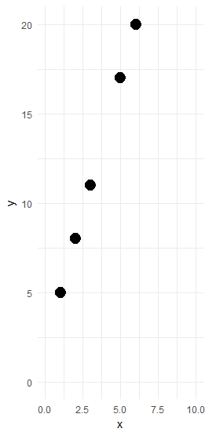
A Very simple example
Input | Output
3 | 11
5 | 17
6 | 20
2 | 8
1 | 5
How can we find the function which models this mathematical relationship?

Slide 24
A Very simple example
Input | Output
3 | 11
5 | 17
6 | 20
2 | 8
1 | 5
How can we find the function which models this mathematical relationship?
A linear regression model tries to find a linear function (Y = Intercept + Slope * X + e) that best fits that data by optimizing some objective function, which in this case is to minimize the Mean Squared Error (MSE). In this example, because it’s a perfectly correlated dataset, the algorithm can find a line where the MSE is zero.

Slide 25
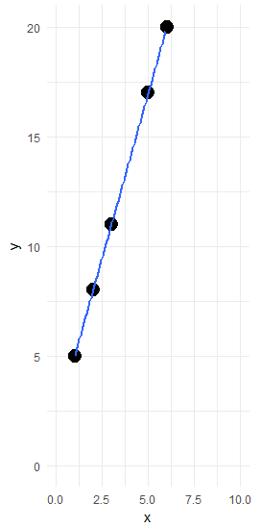
A Very simple example
Input | Output
3 | 11
5 | 17
6 | 20
2 | 8
1 | 5
How can we find the function which models this mathematical relationship?
A linear regression model tries to find a linear function (Y = Intercept + Slope * X + e) that best fits that data by optimizing some objective function, which in this case is to minimize the Mean Squared Error (MSE). In this example, because it’s a perfectly correlated dataset, the algorithm can find a line where the MSE is zero.
The regression model discovered the following coefficients: intercept of 2, and a slope of 3.

Slide 26
A Very simple example
Input | Output
3 | 11
5 | 17
6 | 20
2 | 8
1 | 5
How can we find the function which models this mathematical relationship?
A linear regression model tries to find a linear function (Y = Intercept + Slope * X + e) that best fits that data by optimizing some objective function, which in this case is to minimize the Mean Squared Error (MSE). In this example, because it’s a perfectly correlated dataset, the algorithm can find a line where the MSE is zero.
The regression model discovered the following coefficients: intercept of 2, and a slope of 3.
Y = 2 + 3(X) is our model!

Slide 27
A Very simple example
Input | Output
3 | 11
5 | 17
6 | 20
2 | 8
1 | 5
How can we find the function which models this mathematical relationship?
A linear regression model tries to find a linear function (Y = Intercept + Slope * X + e) that best fits that data by optimizing some objective function, which in this case is to minimize the Mean Squared Error (MSE). In this example, because it’s a perfectly correlated dataset, the algorithm can find a line where the MSE is zero.
The regression model discovered the following coefficients: intercept of 2, and a slope of 3.
Y = 2 + 3(X) is our model!
If we receive a new data input, say 7, we now can predict the output: 2 + 3(7) = 23

Slide 28
Machine learning basics Prediction vs. Inference
There are two main tasks ML tries to address

Slide 29
Machine learning basics Prediction vs. Inference
There are two main tasks ML tries to address
Inference – Discovering how the output is generated as a function of the inputs, offering insights into the relationships between the variables

Slide 30
Machine learning basics Prediction vs. Inference
There are two main tasks ML tries to address
Inference – Discovering how the output is generated as a function of the inputs, offering insights into the relationships between the variables
Prediction – Predicting an outcome (numerical or categorical) when applying a new set of observations to the ML algorithm
https://stats.stackexchange.com/questions/244017/prediction-vs-inference

Slide 31
Machine learning basics Prediction vs. Inference
Prediction does not aim to uncover the interaction of the variables like inference. Instead, prediction only cares about accuracy of the model output. Often these line up well, but this is a subtle difference to be aware of.
“How much extra will a house be worth if it has a view of the river? This is an inference problem. Alternatively, one may simply be interested in predicting the value of a home given its characteristics: is this house under- or over-valued? This is a prediction problem.” -ISLR

Slide 32
Machine learning basics parametric vs. non-parametric MODELS
Parametric models makes assumptions about the functional form of f
Is the functional form linear? Maybe use linear regression
Once a functional form is selected, we calculate the coefficients that best fit that form
Reduces problem of estimating f to estimating a set of parameters or coefficients

Slide 33
Machine learning basics parametric vs. non-parametric MODELS
Parametric models makes assumptions about the functional form of f
Is the functional form linear? Maybe use linear regression
Once a functional form is selected, we calculate the coefficients that best fit that form
Reduces problem of estimating f to estimating a set of parameters or coefficients
Non-parametric models make few assumptions about the functional form of f
Distribution of variables less important
Find a function that matches data as close as possible without overfitting the data
Can fit a much wider range of functional shapes than parametric models

Slide 34
Machine learning basics parametric vs. non-parametric MODELS
Parametric models tend to be easier to interpret but less flexible, while non-parametric models make fewer assumptions about the underlying relationships

Slide 35
Machine learning basics parametric vs. non-parametric MODELS
Parametric models tend to be easier to interpret but less flexible, while non-parametric models make fewer assumptions about the underlying relationships
Linear regression, for instance, is parametric as it makes assumptions about the data being normally distributed. It will tend to have larger errors than a non-parametric approach, but it is much easier to understand, explain, and is less prone to over-fitting the data.

Slide 36
Machine learning basics parametric vs. non-parametric MODELS
Parametric models tend to be easier to interpret but less flexible, while non-parametric models make fewer assumptions about the underlying relationships
Linear regression, for instance, is parametric as it makes assumptions about the data being normally distributed. It will tend to have larger errors than a non-parametric approach, but it is much easier to understand, explain, and is less prone to over-fitting the data.
A smoothing spline is an example of a non-parametric function as it makes no assumptions about the distribution of the input data. However, because it can have many exponential coefficients, it is more difficult to interpret the model coefficients.

Slide 37
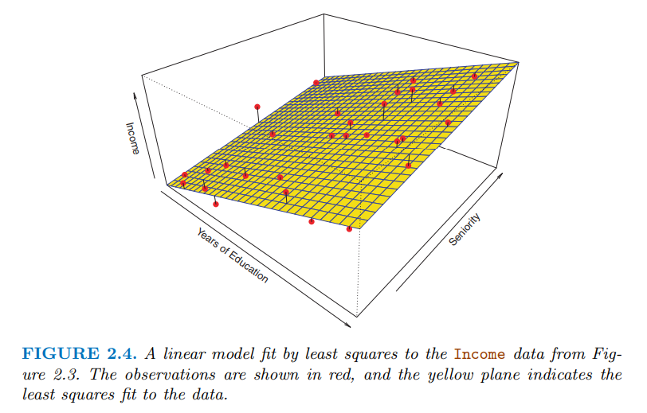
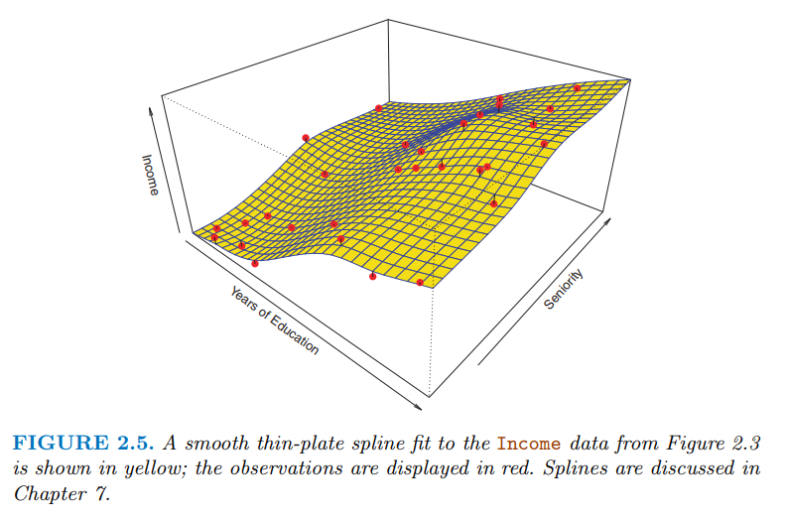
Machine learning basics parametric vs. non-parametric MODELS

Slide 38
Machine learning basics Trade-off between accuracy and interpretability
This is really a question of flexibility: what functional forms are we allowing f(X) to be? Is it restricted to be linear, or can it be a complex shape?

Slide 39
Machine learning basics Trade-off between accuracy and interpretability
This is really a question of flexibility: what functional forms are we allowing f(X) to be? Is it restricted to be linear, or can it be a complex shape?
In the last slide, we saw how the non-parametric approach is more flexible and more accurate. But, it’s much more difficult to express that relationship in an inference setting.

Slide 40
Machine learning basics Trade-off between accuracy and interpretability
This is really a question of flexibility: what functional forms are we allowing f(X) to be? Is it restricted to be linear, or can it be a complex shape?
In the last slide, we saw how the non-parametric approach is more flexible and more accurate. But, it’s much more difficult to express that relationship in an inference setting.
A rigid model, such as a linear regression, is extremely good for inference as you can see the direct changes in estimation of Y when you change a single input. A model such as neural networks, however, is extremely flexible, and more accurate, but comes with a loss of interpretability.

Slide 41
Machine learning basics Trade-off between accuracy and interpretability
This is really a question of flexibility: what functional forms are we allowing f(X) to be? Is it restricted to be linear, or can it be a complex shape?
In the last slide, we saw how the non-parametric approach is more flexible and more accurate. But, it’s much more difficult to express that relationship in an inference setting.
A rigid model, such as a linear regression, is extremely good for inference as you can see the direct changes in estimation of Y when you change a single input. A model such as neural networks, however, is extremely flexible, and more accurate, but comes with a loss of interpretability.
In general, if the practitioner is only interested in inference, a more rigid approach such as linear regression will offer a great level of interpretability, even if there may be a more accurate, but murky, model.

Slide 42
Machine learning basics Supervised vs. unsupervised learning
In supervised learning, the algorithm is given a set of inputs and desired outputs. In unsupervised learning no labels are given, leaving any pattern or structure discovery up to the algorithm.

Slide 43
Machine learning basics Supervised vs. unsupervised learning
In supervised learning, the algorithm is given a set of inputs and desired outputs. In unsupervised learning no labels are given, leaving any pattern or structure discovery up to the algorithm.
Since unsupervised learning has no “target” variable, models such as linear regression do not fit into this category. However, there is still a lot of power in these methods for discovering relationships among the variables, and across observations.

Slide 44
Machine learning basics Supervised vs. unsupervised learning
In supervised learning, the algorithm is given a set of inputs and desired outputs. In unsupervised learning no labels are given, leaving any pattern or structure discovery up to the algorithm.
Since unsupervised learning has no “target” variable, models such as linear regression do not fit into this category. However, there is still a lot of power in these methods for discovering relationships among the variables, and across observations.
For unsupervised, we have no target, only input variables X.

Slide 45
Machine learning basics Supervised vs. unsupervised learning
In supervised learning, the algorithm is given a set of inputs and desired outputs. In unsupervised learning no labels are given, leaving any pattern or structure discovery up to the algorithm.
Since unsupervised learning has no “target” variable, models such as linear regression do not fit into this category. However, there is still a lot of power in these methods for discovering relationships among the variables, and across observations.
For unsupervised, we have no target, only input variables X.
Our focus will be on supervised learning techniques

Slide 46
Machine learning basics regression vs classification
Regression and classification are often supervised learning problems

Slide 47
Machine learning basics regression vs classification
Regression and classification are often supervised learning problems
Regression techniques are used to predict continuous outputs/targets
Level of income ($0 - $infinite)
Probability of disease (0% - 100%)

Slide 48
Machine learning basics regression vs classification
Regression and classification are often supervised learning problems
Regression techniques are used to predict continuous outputs/targets
Level of income ($0 - $infinite)
Probability of disease (0% - 100%)
Classification techniques are used to predict discrete outputs/targets
Default on debt (yes/no)
Cancer diagnosis (type of Leukemia)

Slide 49
Machine learning basics regression vs classification
Regression and classification are often supervised learning problems
Regression techniques are used to predict continuous outputs/targets
Level of income ($0 - $infinite)
Probability of disease (0% - 100%)
Classification techniques are used to predict discrete outputs/targets
Default on debt (yes/no)
Cancer diagnosis (type of Leukemia)

Slide 50
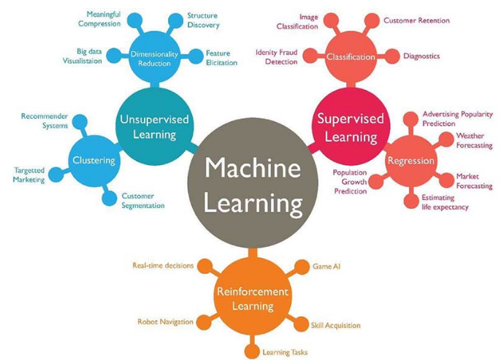
https://www.techleer.com/articles/203-machine-learning-algorithm-backbone-of-emerging-technologies/

Slide 51
Machine learning basics Reading assignment
Machine learning applications in cancer prognosis and prediction https://www.sciencedirect.com/science/article/pii/S2001037014000464
Discusses many recent successes of applying various regression and classification techniques to cancer data sets
Read and we will briefly discuss at the beginning of class next week

